Slide 1
Regional UN evaluation networks: Opportunities and challenges for strengthening the decentralized evaluation function in the UN
UN Evaluation Development Group for Asia and the Pacific (UNEDAP), the UN Network for Evaluation in Sub-Saharan Africa (UNNESSA) and the UN Network for Evaluation in Latin America and the Caribbean (UNELAC)

Slide 2
Timeline
UNNESA created on: March 2020
UNELAC created on: 2010 as UN M&E WG/ June 2022 as UNELAC
UNEDAP created on: February 2007

Slide 3
UNNESSA
Mission
Strengthen the evaluation function in the UN system in the Eastern and Southern Africa region
Add value to evaluation work of the UNNEESA member agencies and the countries they serve.
Membership
14 agencies across Sub-Saharan Africa
Working areas/key initiatives
Evaluation capacity development
Technical support on evaluations
Knowledge exchange around evaluations
Notes:
UNNESSA is a regional, voluntary, member-based, interagency network launched by United Nations agencies. UNNESSA’s goals are as follows:
1. To support evaluation capacity development efforts within the UN network (Working Group 1)
2. To strengthen United Nations Sustainable Development Cooperation Framework (UNSDCF) and joint evaluations (Working Group 2)
3. To exchange evaluation-related knowledge and practices (Working Group 3)

Slide 4
UNEDAP
Mission
Aims to promote an evaluation culture and coherence of evaluation practices in the UN system
Membership
Consists of evaluation experts of 11 regional offices (ILO, IOM, UNICEF, UNDP, UN ESCAP, UNESCO, UN Women, UNFPA, UNOPS, WFP, FAO) and UNDCO-AP
Included in the structure of the Regional Collaborative Platform in 2021
Working areas/key initiatives
Organizes in-person or online evaluation trainings for all UN Agencies in the Asia-Pacific countries every year
Provides technical advice to strengthen evaluations carried out by UN agencies in the Asia and the Pacific region, particularly UNSDCF and joint evaluations
Advocates for influential evaluations to senior managers in the region
Notes:
UNEDAP also provides ad-hoc additional support as requested by DCO: e.g. RBM trainingsAP: RBM trainings,

Slide 5
UNELAC
Mission
Strengthen evaluation function across UN system in LAC
Promote coordination, collaboration and foster synergies among UN entities around evaluations
Membership: 15 officers from 9 agencies with Regional Offices in LAC
Working areas/key initiatives i) Evaluation Capacity development ii) Technical support & QA to evaluations iii) Country -led SDG evaluations & NECD iv) joint evaluations & knowledge products

Slide 6
PANEL SESSION
1
Capacity Development
2
DCO and Quality Assurance
3
Challenges to establish & sustain an active Network
UNEDAP
Speakers:
Angeline Wambada, IOM
Oyuna Chuluundorj, UNFPA
UNNESSA
Speakers:
Kay Lau, UN Women
-
-
UNELAC
Speakers:
Natalia Acosta, WFP
Michael F. Craft, UN Women
-

Slide 7
Capacity Development
UNEDAP in-person or online evaluation training for all UN Agencies in the Asia-Pacific countries:
It has been offered since 2009 with an objective of enhancing the quality and effectiveness of UN evaluations in the region;
Each course trains approximately 35 staff from various UN agencies working in the region on evaluation management, including RCOs.
Includes half-day workshops or online sessions on UNSDCF evaluations in collaboration with the Development Coordination Office (DCO);
Colleagues from countries who recently conducted UNSDCF evaluations are invited to present and discuss challenges and good practices.

Slide 8
Structure of the UNEDAP evaluation course
1
2
Helping stakeholders use the evaluation
Preparing for an evaluation
Supporting the evaluation team
3
Step 1: Identify users and use
Step 1: What data sources are available?
Step 1: Share findings and recommendations
Step 2: Make sure it can be evaluated
Step 3: Define purpose and scope of the evaluation
Step 2: Provide quality control for the inception phase
Excursion: Data visualization for evaluations
Step 4: What questions should it answer?
Step 3: Provide support and supervision to evaluation team
Step 2: Coordinate the management response
Step 5: Define approach and methodologies
Step 6: Put it all together in Terms of Reference
Step 4: Support and ensure the quality of the evaluation report
Step 3: Using evaluation for managing results
Excursion: Ethics in evaluations

Slide 9
DCO and Quality Assurance
2022 activity
Quality assuring UNDAF / UNSDCF evaluation TORs, inception and final reports
Using standard UNSDCF template and providing collated feedback consistent with UNSDCF guidance
Clarifying ways of working with the DCO, RCO and country teams
Opportunity to increase support across planning and managing evaluations
Opportunity to strengthen forward planning to ensure sufficient lead time

Slide 10
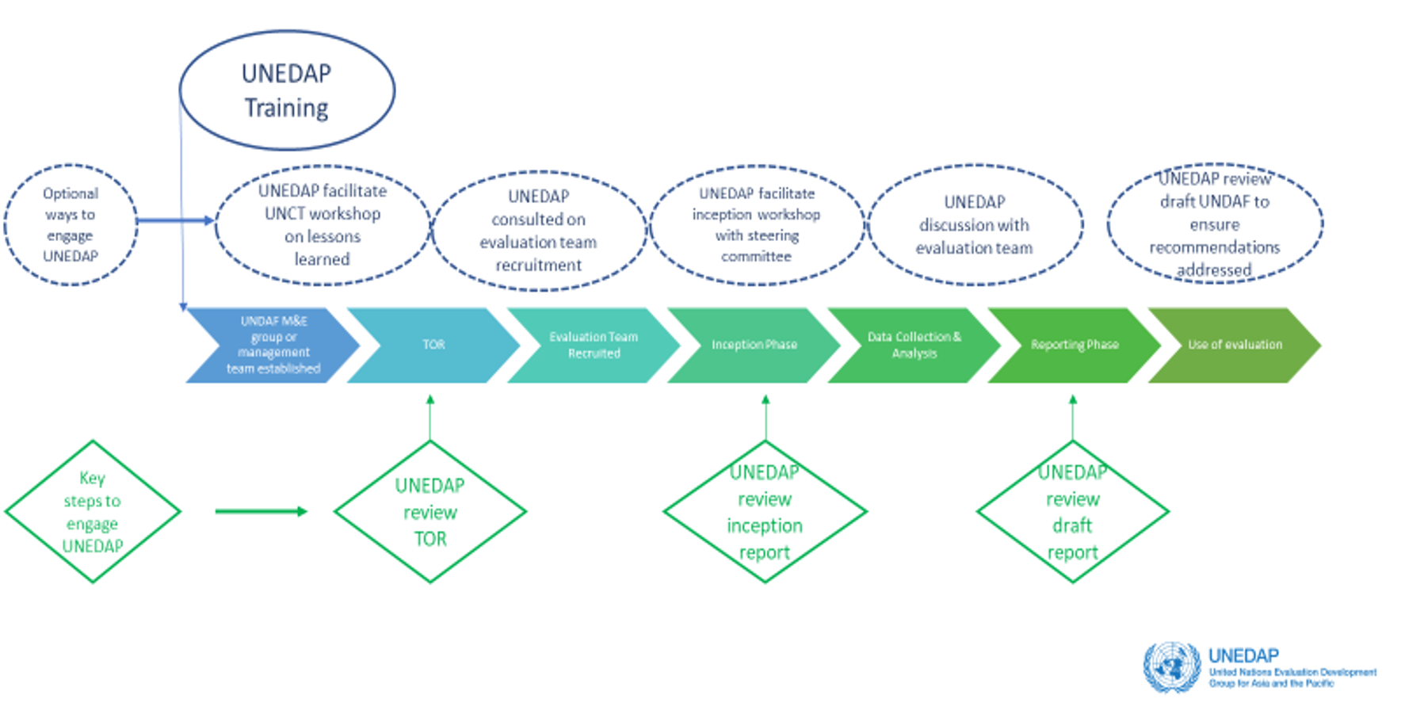
Support to UNSDCF evaluations in partnership with DCO
Notes:
Provide technical advice to strengthen evaluations carried out by UN agencies in the Asia and the Pacific region, particularly UNSDCF and joint evaluations.
In collaboration with DCO Evaluation Adviser in HQ and regional DCO, UNEDAP support includes reviewing evaluation Terms of Reference (TOR), sharing rosters of evaluation consultants, selecting evaluation team and quality assuring inception and evaluation reports.
1-2 UNEDAP members function as focal points forUNSDCF evaluations working closely with RCOs managing evaluations and providing technical support

Slide 11
Challenges to establish & sustain a Network
> Formalizing the group under the auspices of the Regional Collaborative Vice Chairs
> Time availability of members to sustain an active and continuous engagement
> Kicking off the work in some of the working groups (i.e. joint assessments and evaluations)
SUCCESS FACTORS:
having engaged co-chairs leading the network and working group leads
Focus on concise/ concrete activities where many can contribute

